Slide 1
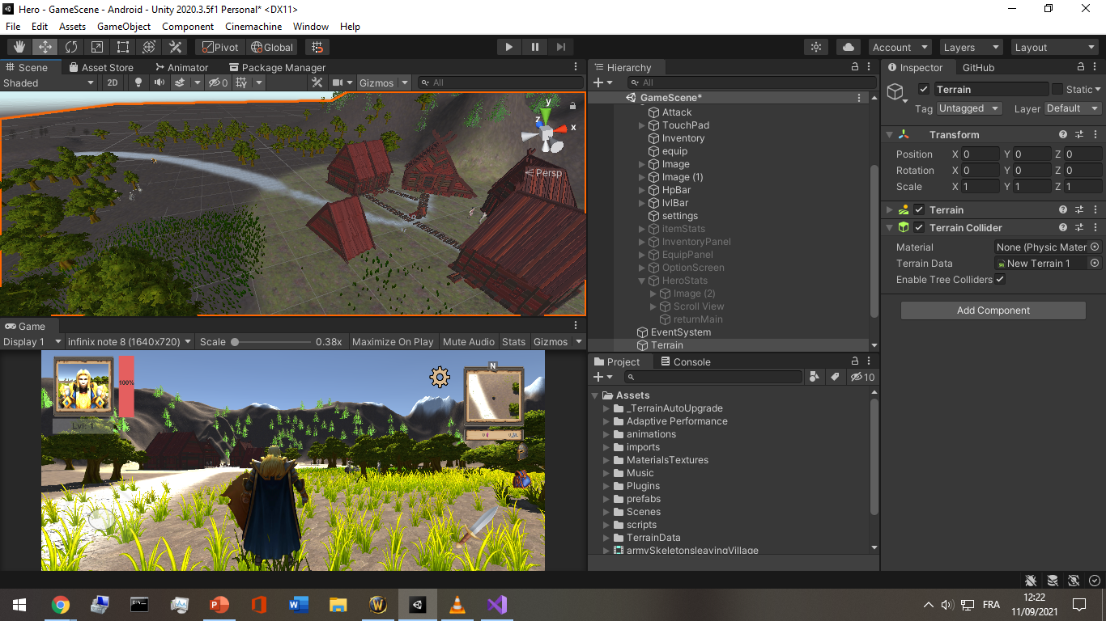
Hero: the skeleton invasion
3d offline mini-game built with unity gameEngine

Slide 2
Content
This presentation will include breifings about 4 major parts:
User Interface.
Animation.
Gameplay.
Classes and data storage.

Slide 3
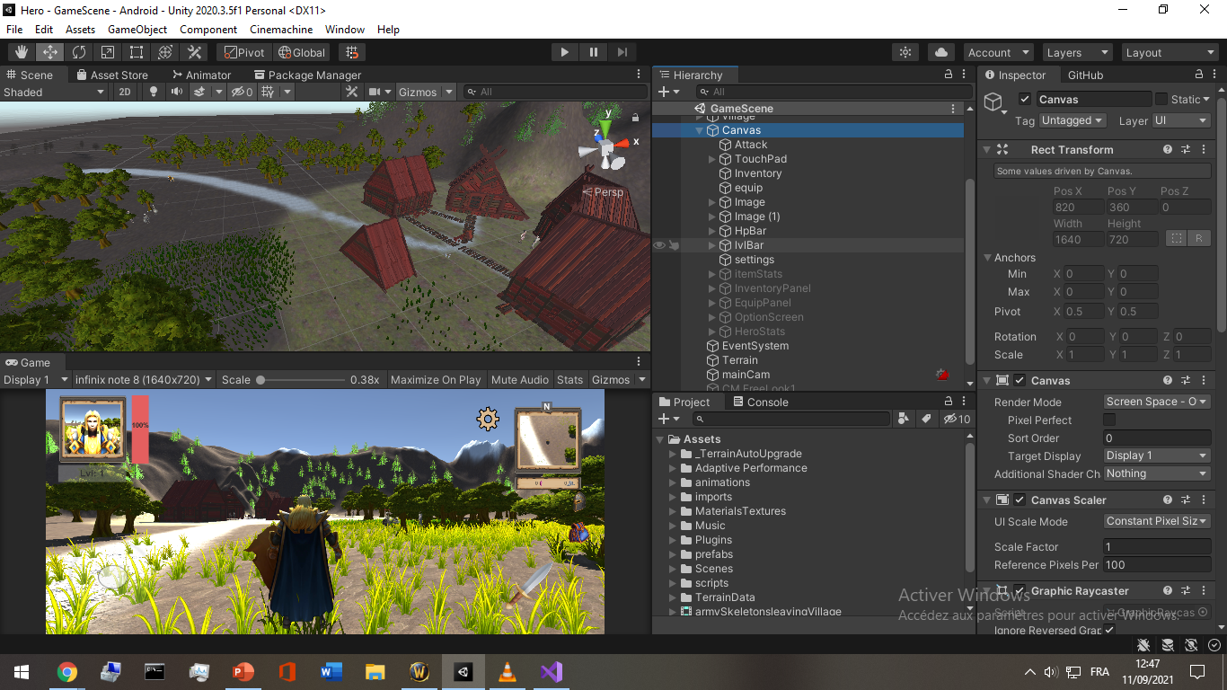
User interface

Slide 4
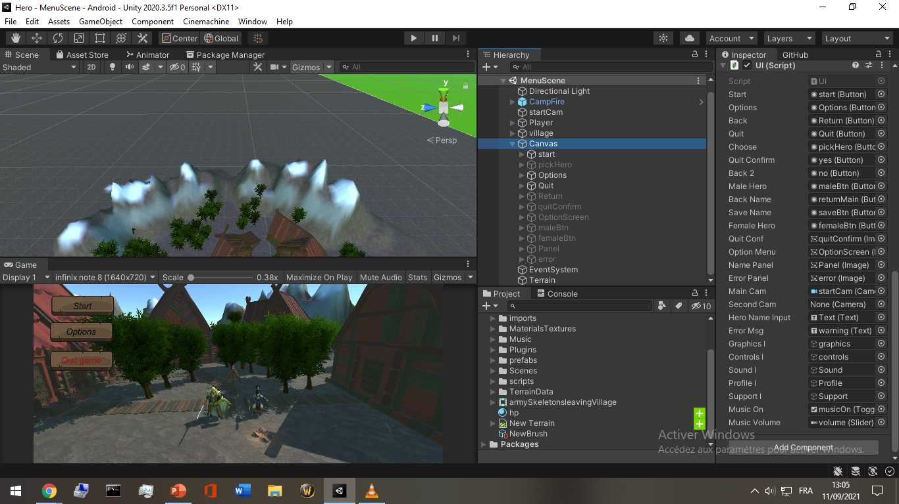
User interface

Slide 5
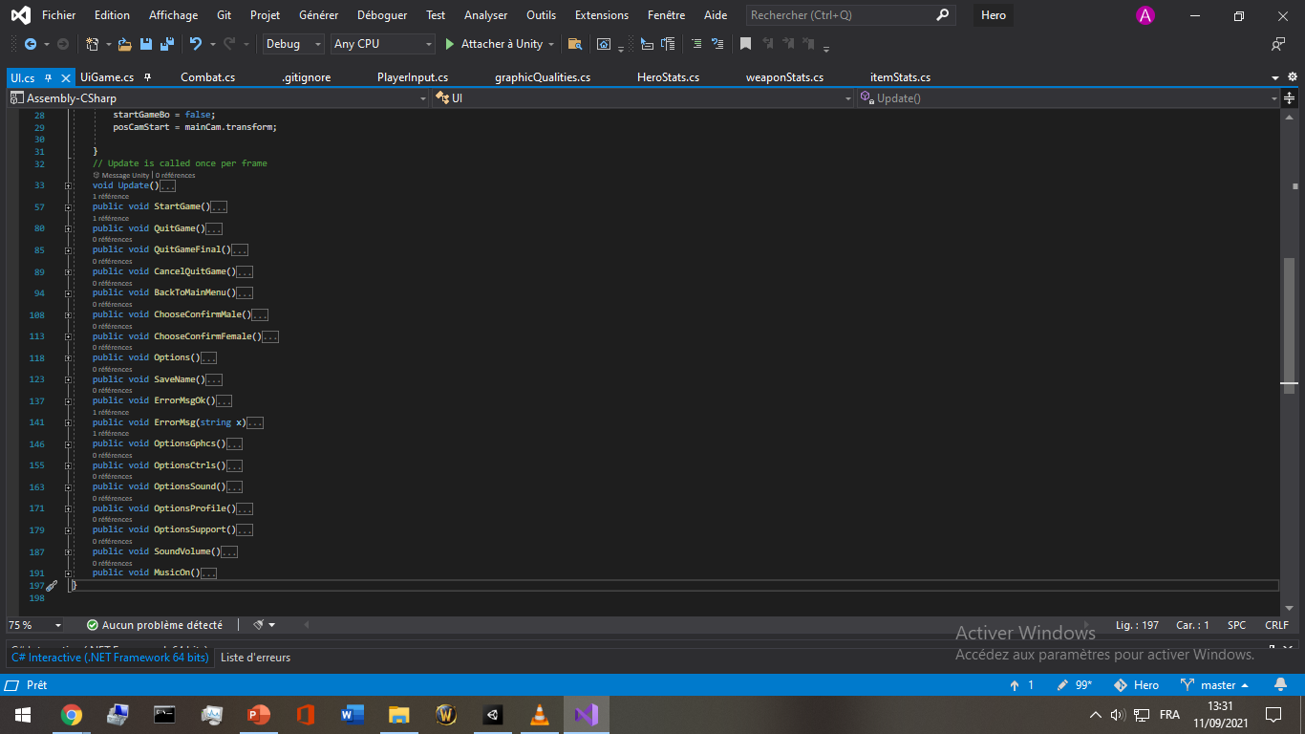
User interface

Slide 6
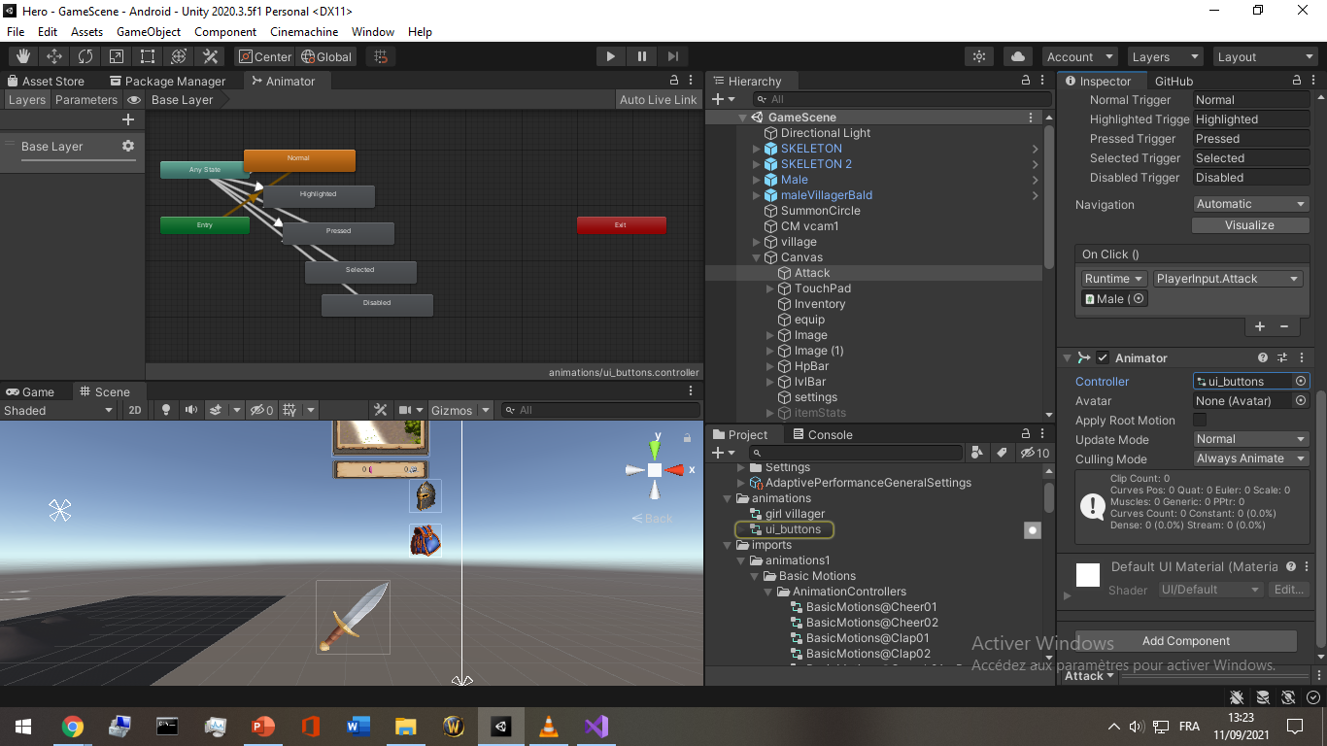
Animation

Slide 7
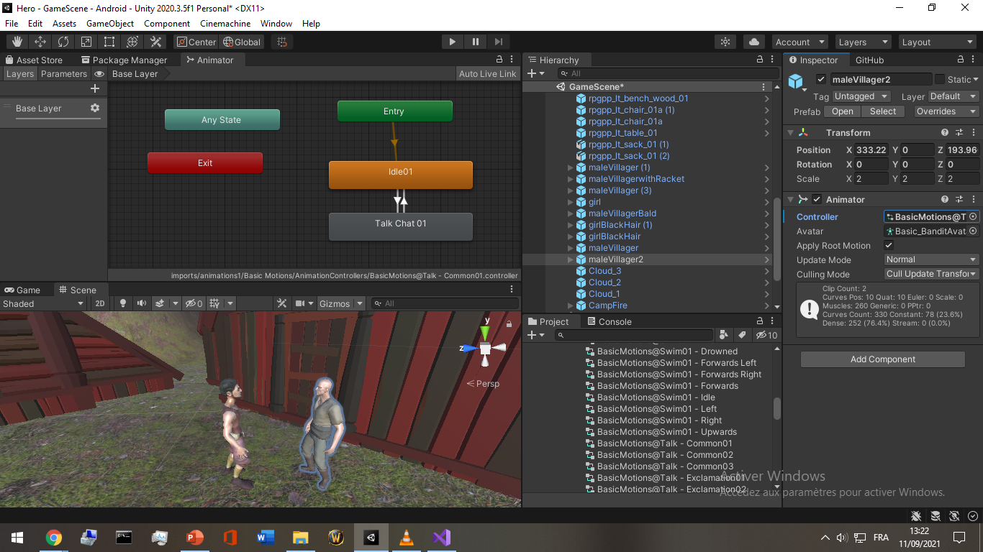
Animation

Slide 8
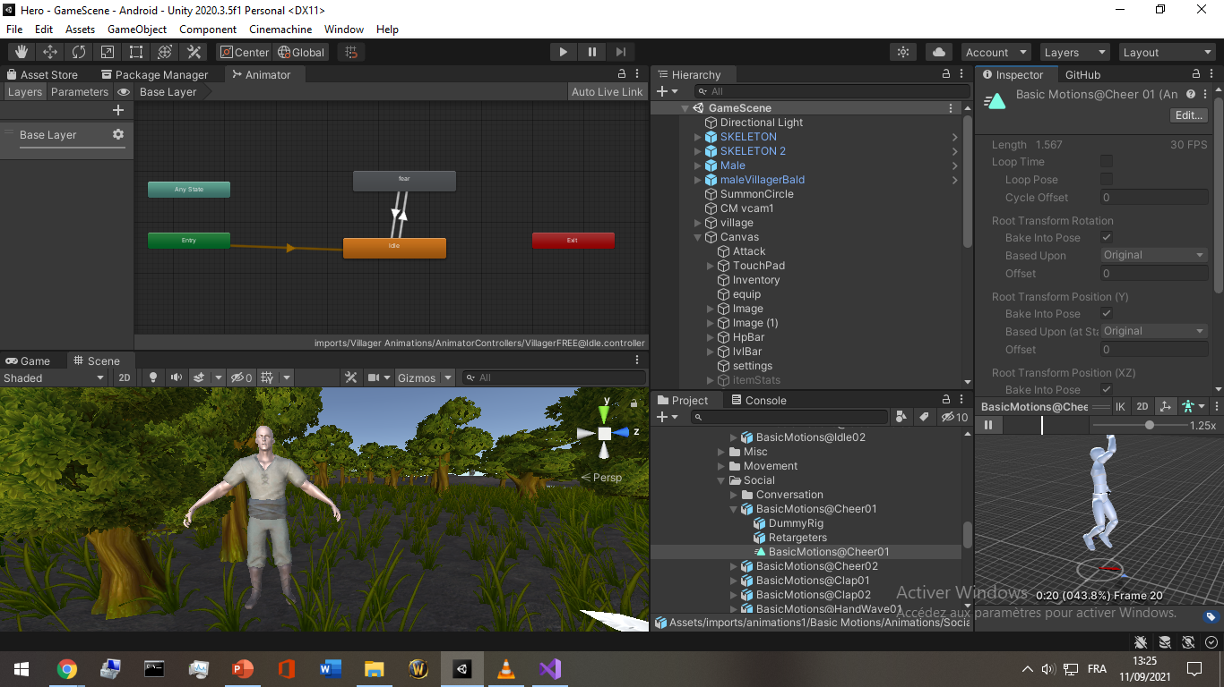
Animation

Slide 9
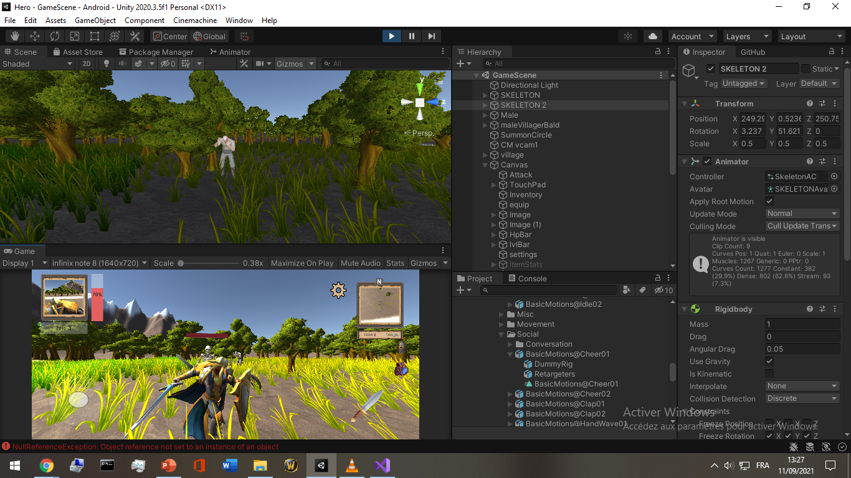
Gameplay

Slide 10
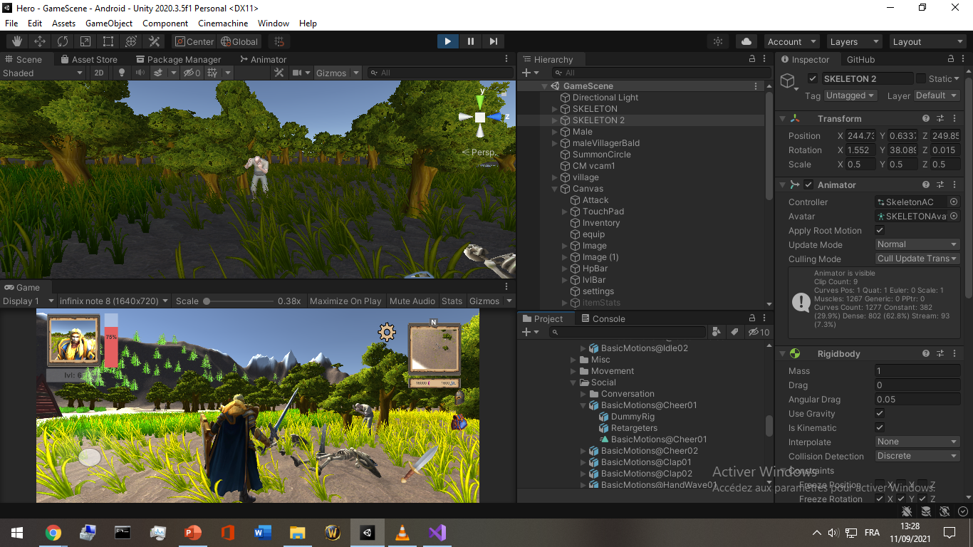
Gameplay

Slide 11
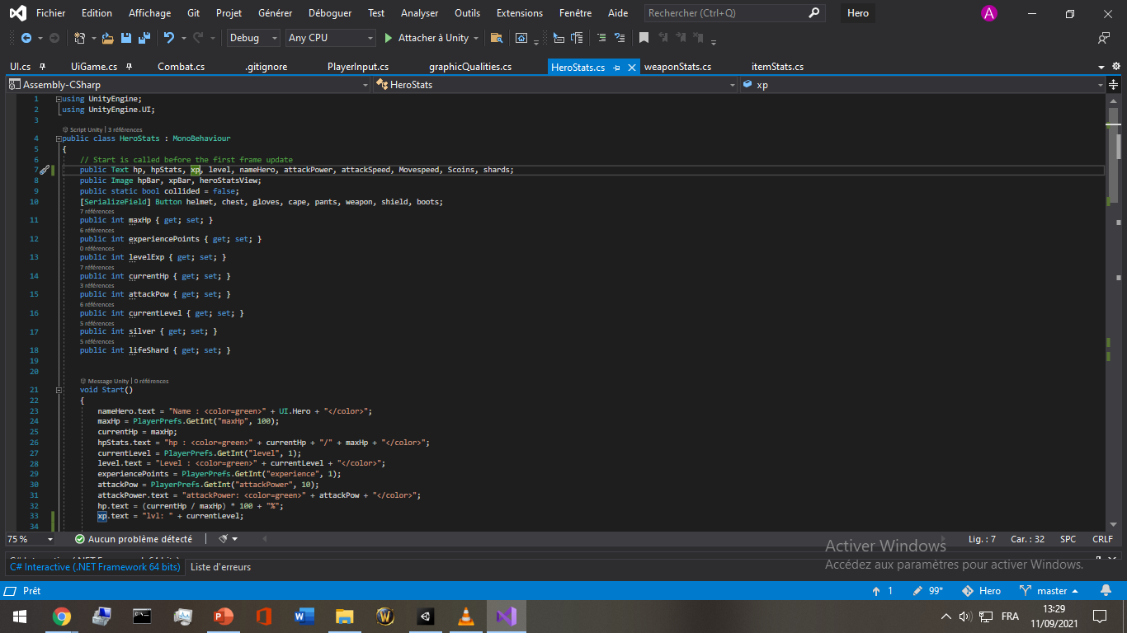
Classes and variables

Slide 12
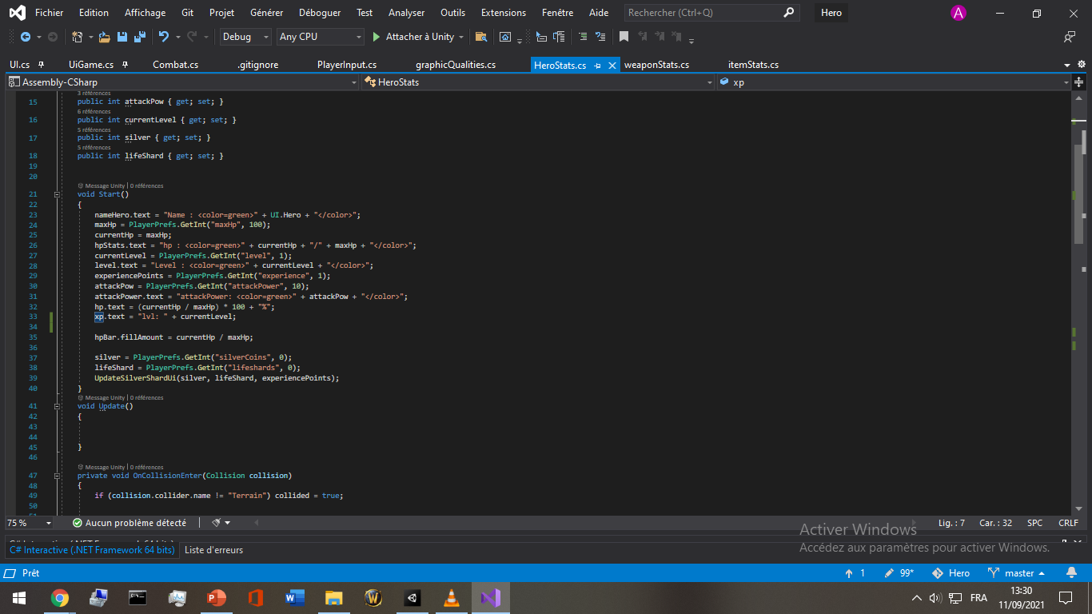
Classes and variables

Slide 13
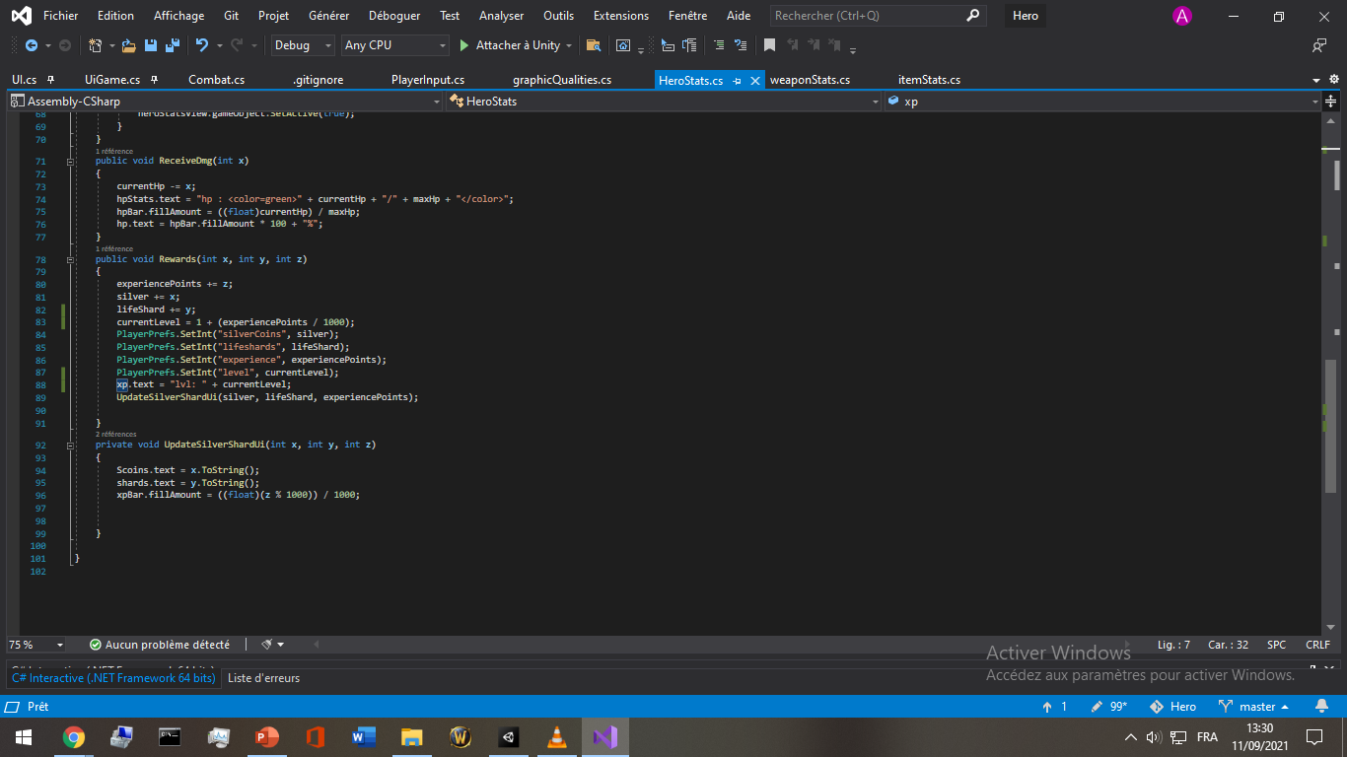
Classes and variables

Slide 14
Conclusion
The unity game engine along with the microsoft .net are really powerful tools used in every sector today ,industrial tutorials and safety, concepting and testing,video games, films, animes, art.

